Slide 1
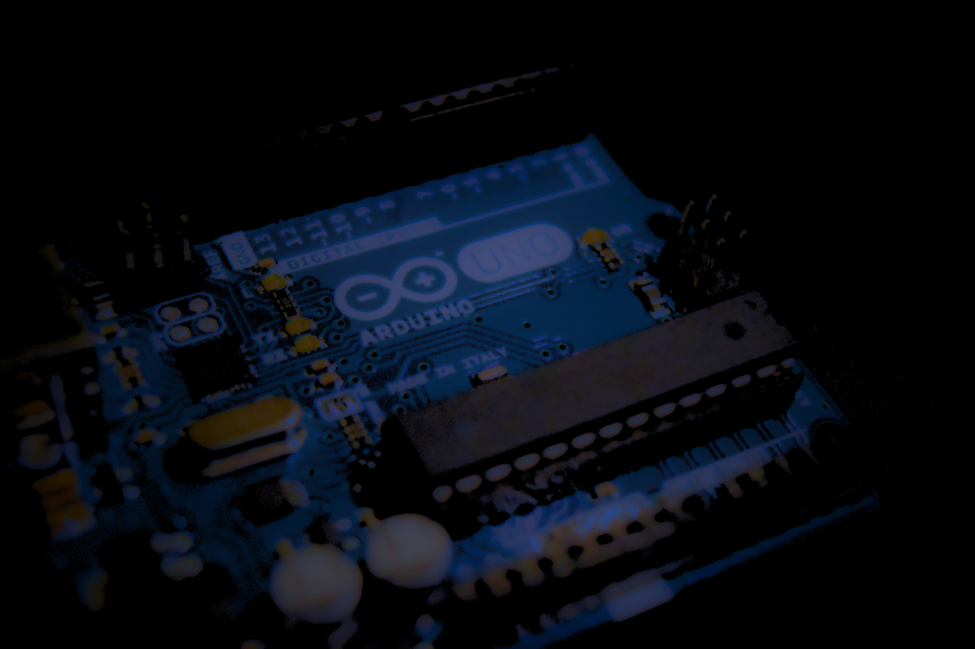
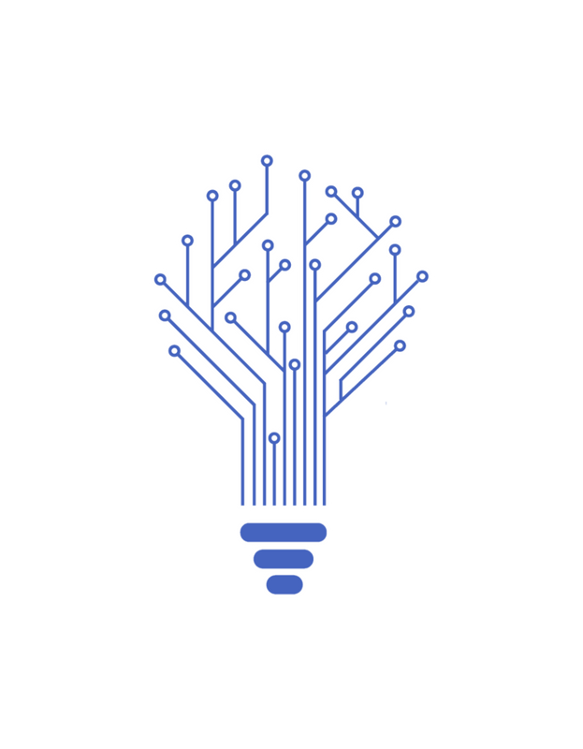

IOTICS CLUB PRESENTS!
AIoT Workshop series: Introduction session

Slide 2

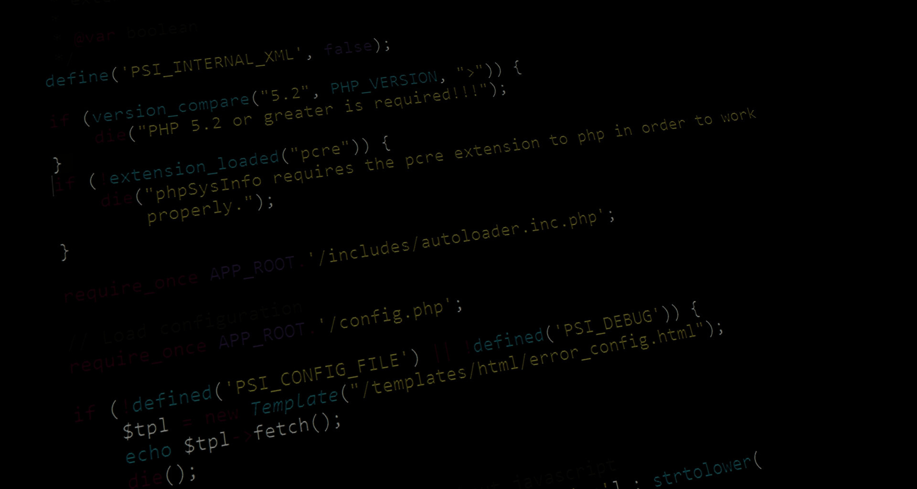
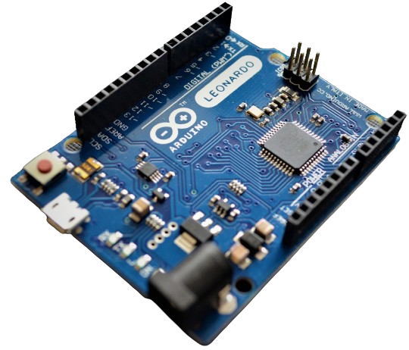
List of sessions
Interfaacing HCSR04 sensor with Adafruit IO and Blynk
Obstacle Avoidance + ESP32 cam Robot
Intro to ML + using an ML model to make predictions based on a given sensor data.
Intro to ANN & CNN + Object detection robot.
Haar cascades + CamVisioTech

Slide 3
What is Arduino?
Arduino is an open-source electronics platform.
Hardware includes a physical circuit board with a microcontroller and various input/output pins.
Software includes an integrated development environment for coding (Arduino IDE)
Users can write, compile, and upload code to the Arduino board.
Arduino is widely used by hobbyists, students, artists, and professionals.
It enables the creation of interactive electronic projects.

Slide 4

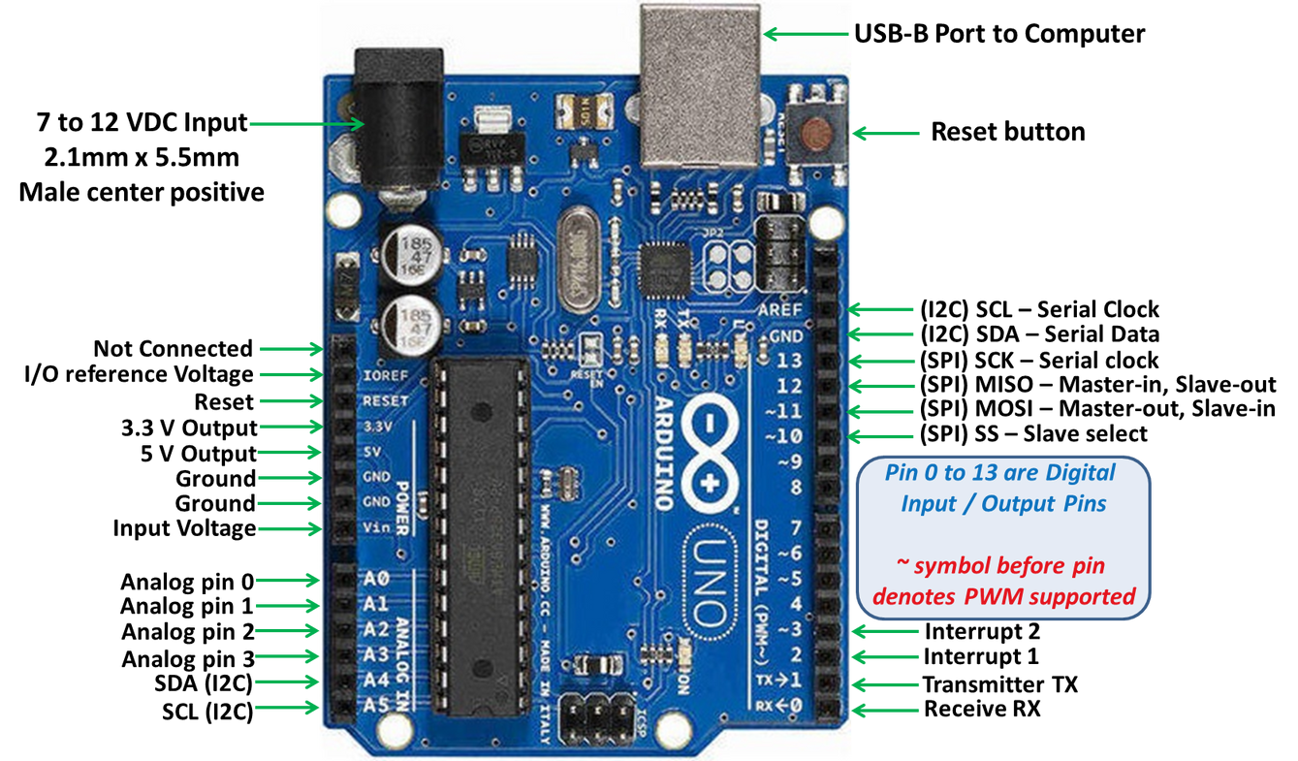
PIN DIAGRAM OF
ARDUINO UNO

Slide 5
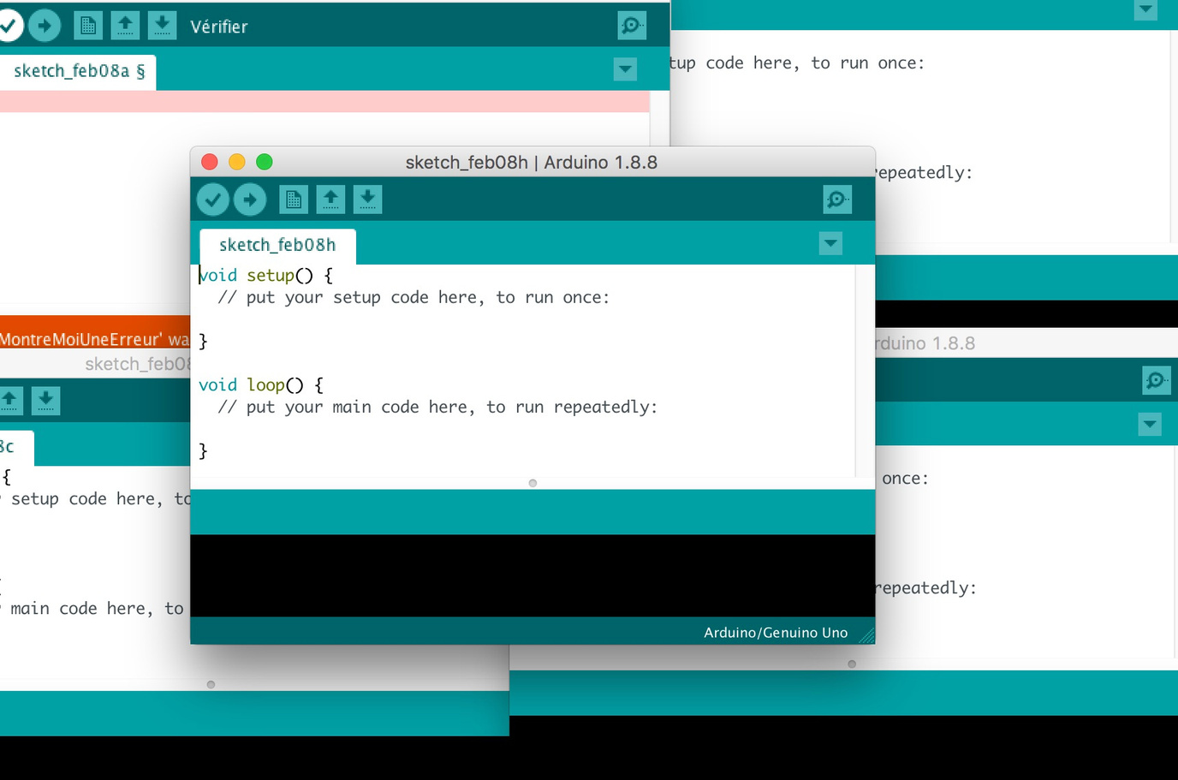
ARDUINO & C
Syntax: Arduino programming language is essentially C/C++ with some simplifications and specific libraries. Thus, they share similar syntax rules, such as variable declaration, function syntax, control structures (like loops and conditionals), and operators.
Data Types: Both Arduino and C support similar data types such as integers (int), floating-point numbers (float), characters (char), and arrays.
Variables: They both use variables to store and manipulate data. Variables must be declared with a specific type before they can be used.
Libraries: Arduino provides its own set of libraries for common tasks like controlling hardware components (e.g., sensors, actuators). Similarly, C has libraries for various functionalities, though they may not be as specific to hardware interfacing as Arduino libraries.

Slide 6
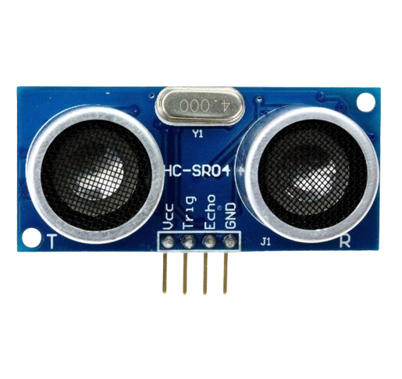
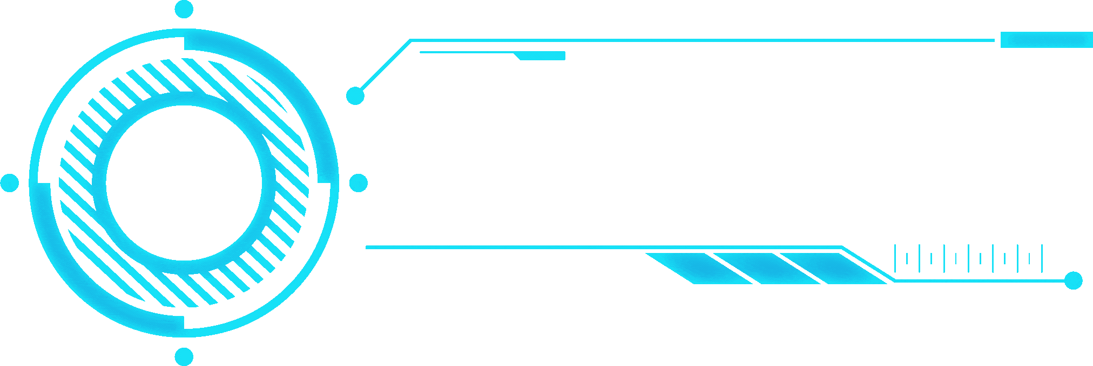
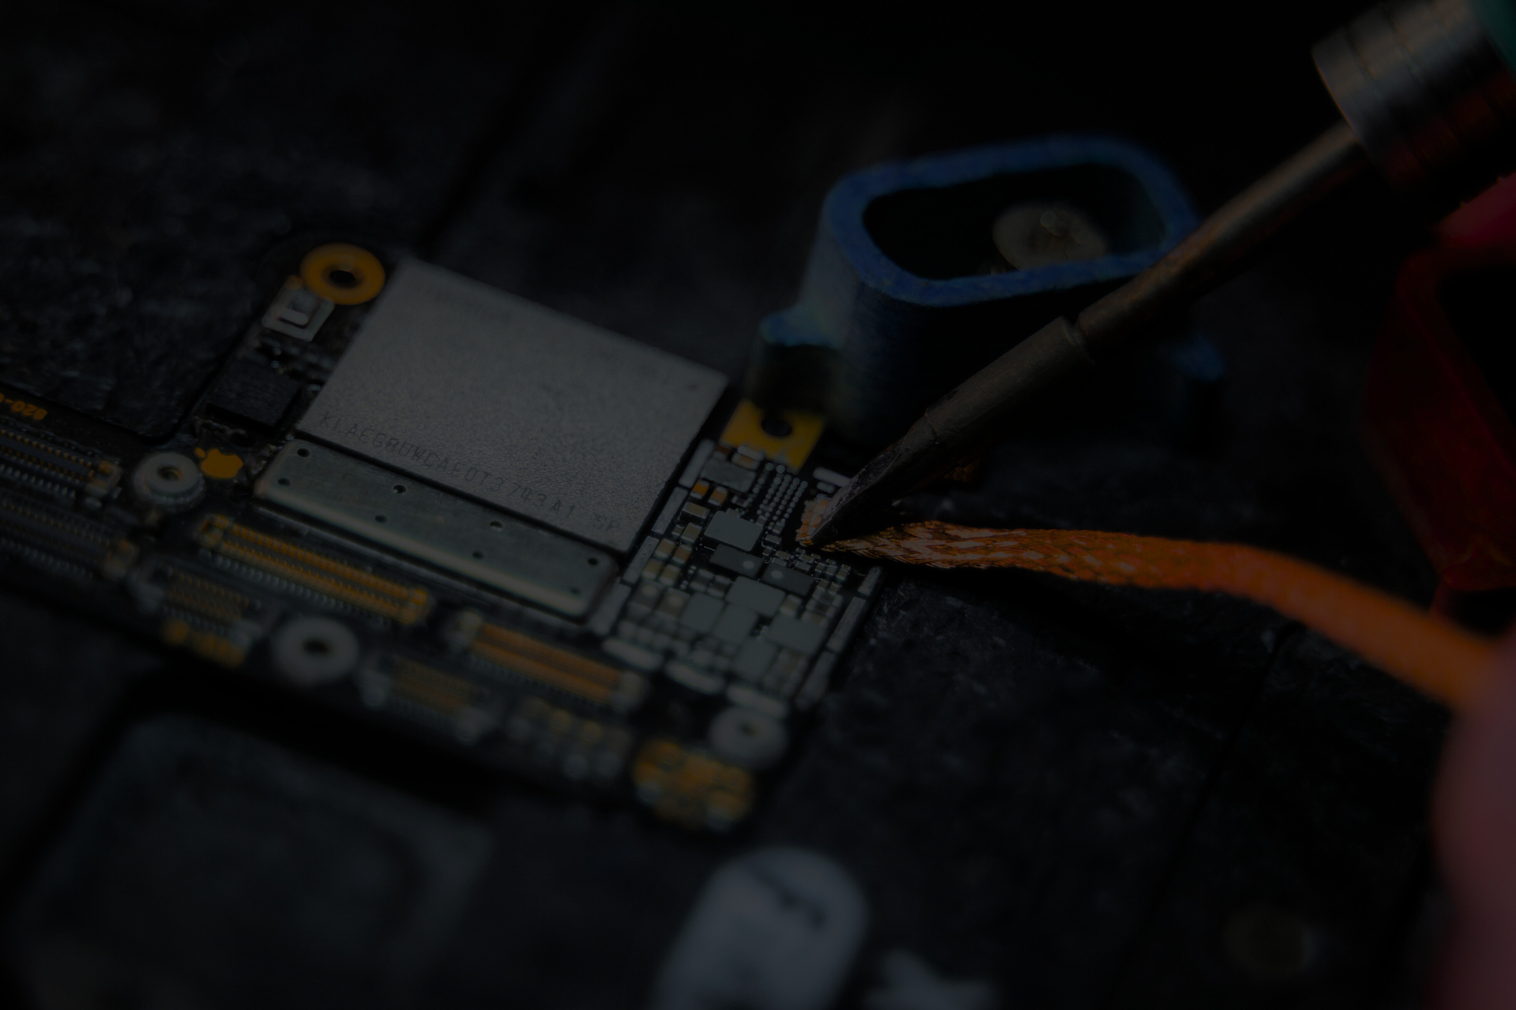
HC-SR04 Ultrasonic Distance Sensor
The HC-SR04 is an ultrasonic distance sensor module used in robotics and automation projects.
It consists of an ultrasonic transmitter and receiver.
Works by sending an ultrasonic pulse and measuring the time it takes for the pulse to bounce back.
Distance is calculated using the speed of sound in air and the time taken for the pulse to return.
Typically has a range of 2cm to 400cm.
Accuracy can be affected by environmental factors and interference.
Commonly used in applications requiring non-contact distance measurement.

Slide 7

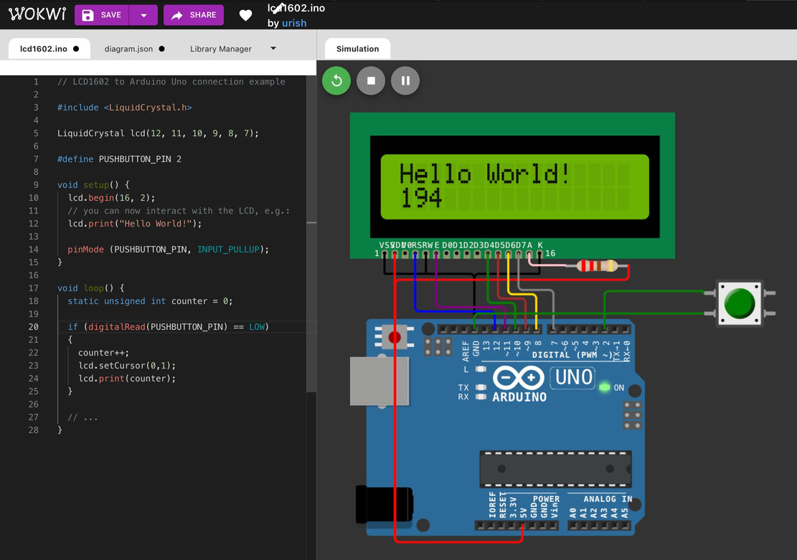
What is
Wokwi?
Online platform for virtual electronics prototyping.
Allows users to design, simulate, and test electronic circuits and Arduino projects.
Features user-friendly interface and extensive component libraries.
Real-time simulation capabilities.

Slide 8
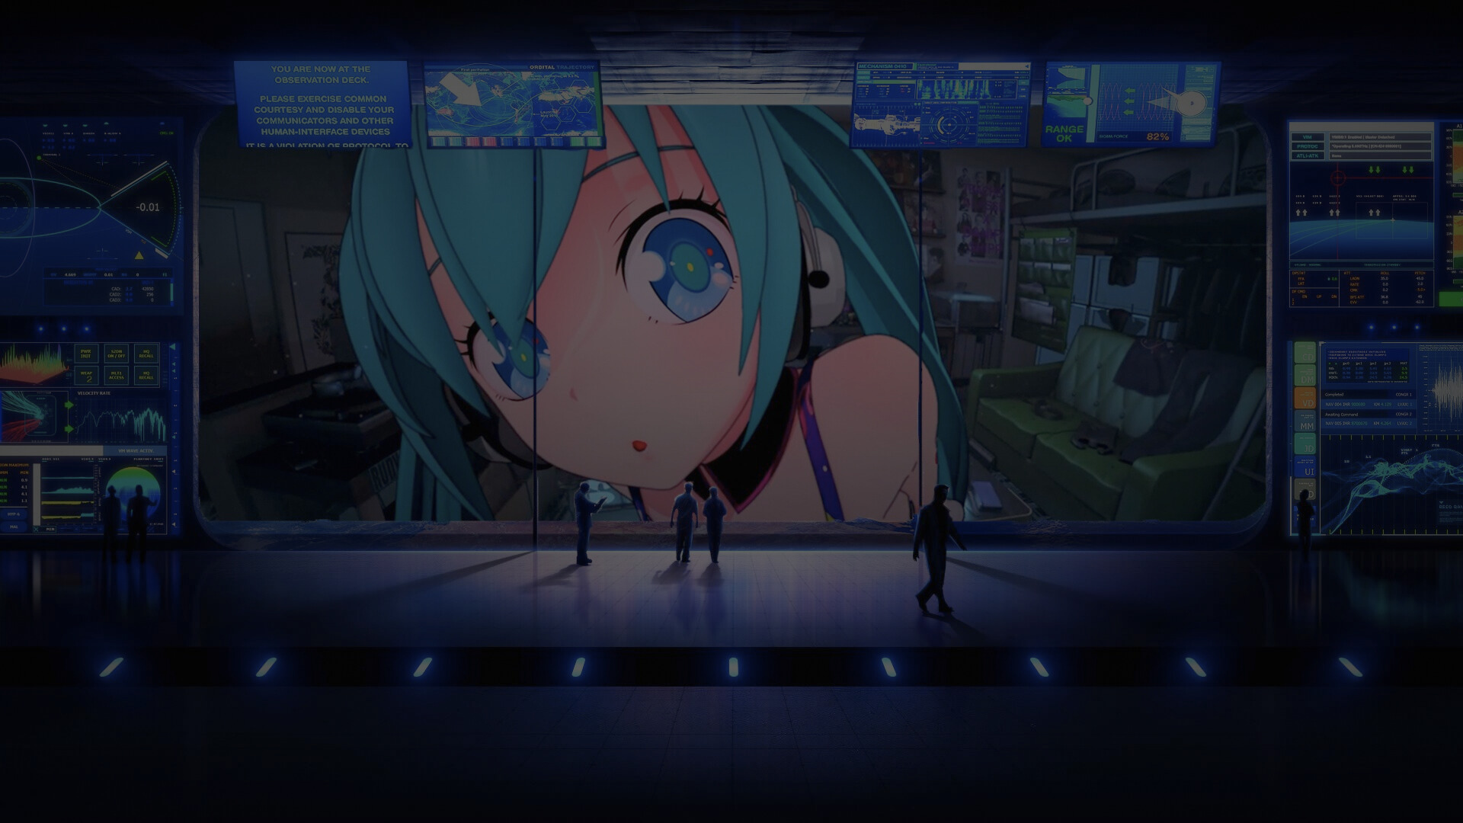
CIRCUIT & CODE

Slide 9
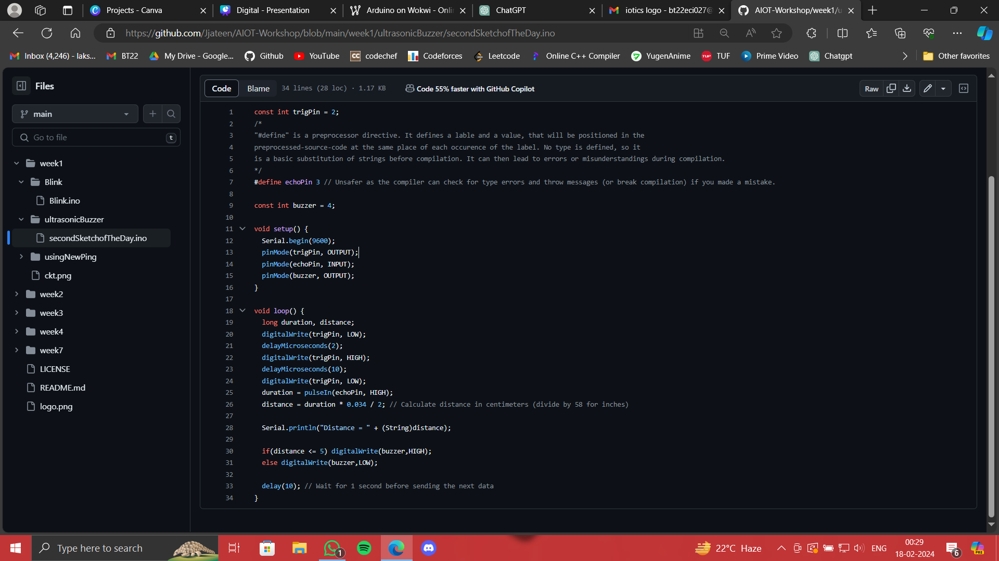
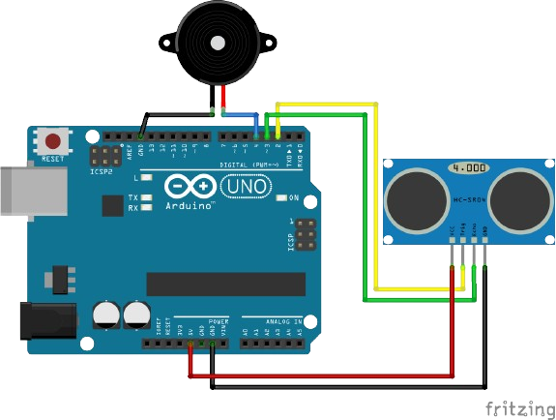

Slide 10
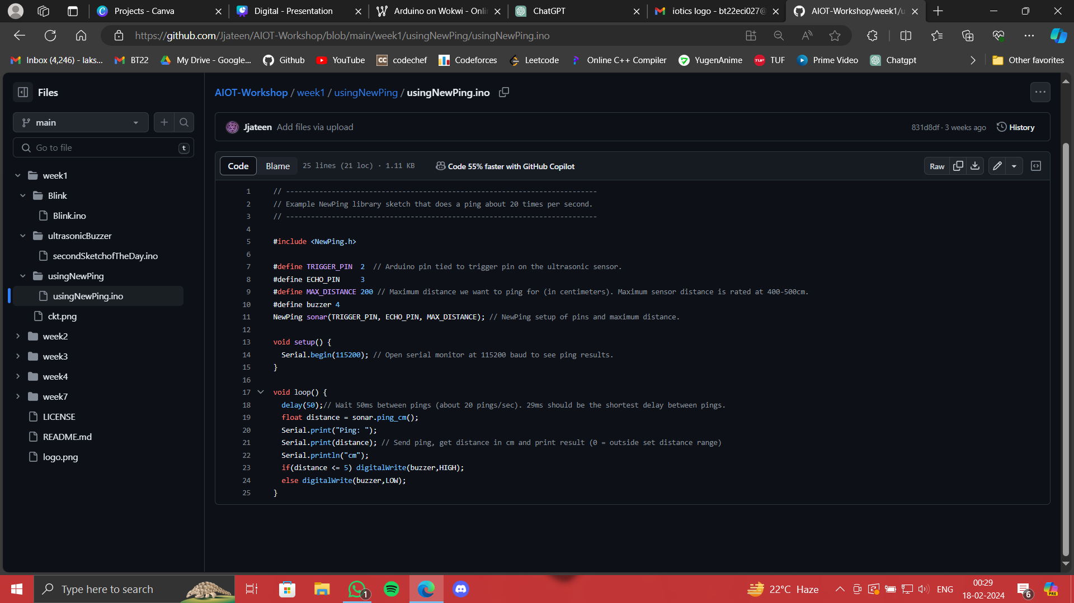
The main difference between the two codes lies in their approach to handling ultrasonic sensor functionality. The first code directly manipulates pins and utilizes the pulseIn() function for distance measurement, offering more control at a lower level but with potentially more complexity. In contrast, the second code employs the NewPing library, abstracting away low-level details and simplifying sensor usage with dedicated functions, providing a more streamlined and user-friendly approach to distance measurement.

Slide 11
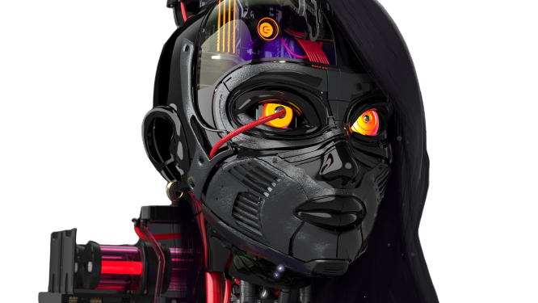
Thank you all for joining today's session!

Slide 12



HI!
MEET OUR TEAM
AYUSH
KARAPAGALE
CLUB HEAD
JJATEEN GUNDESHA
CO-LEAD

Slide 13
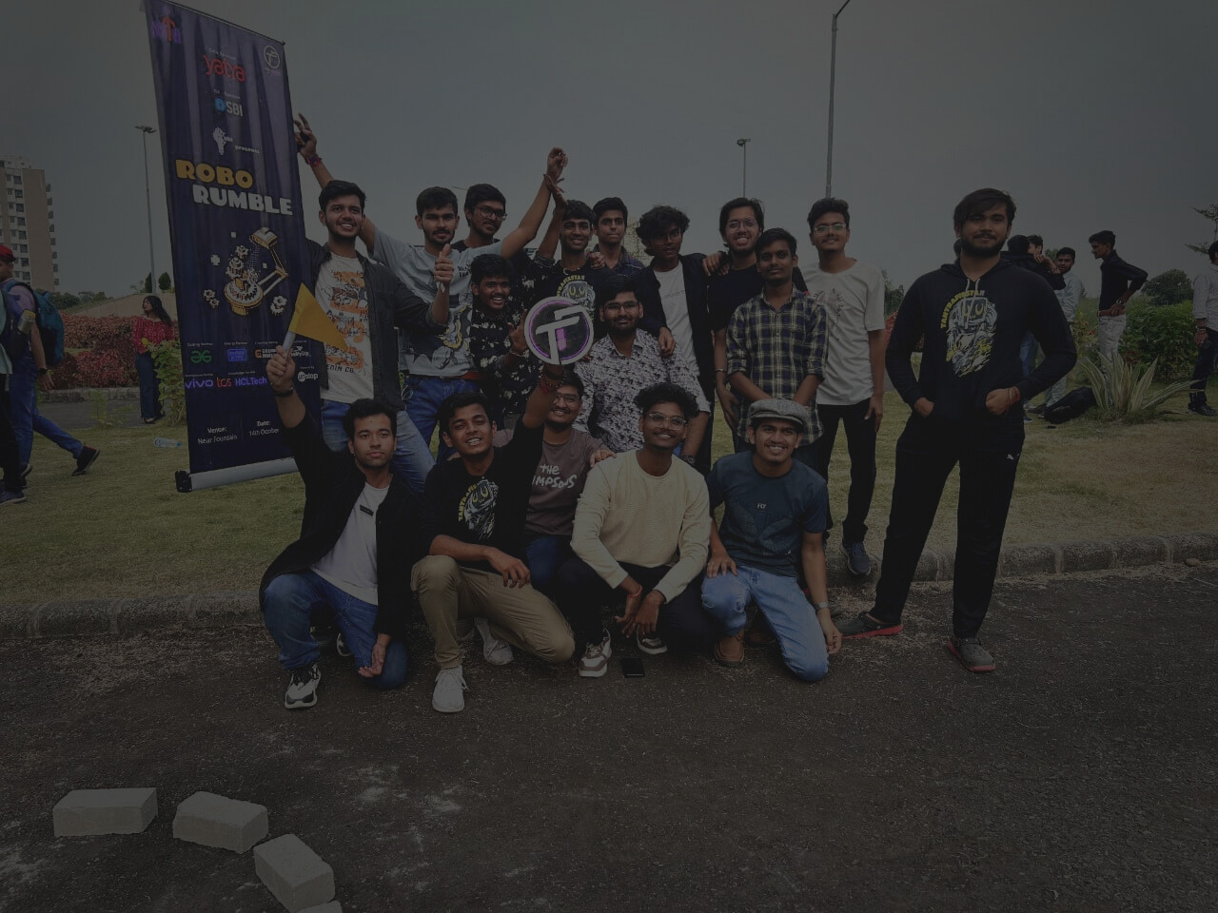



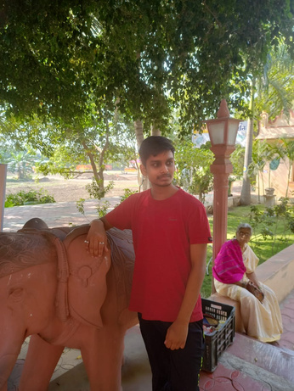



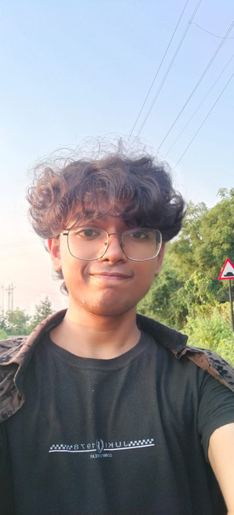
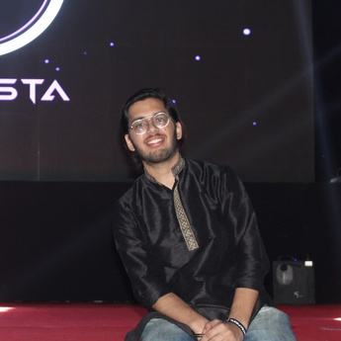




OUR CORE MEMBERS
Akshit Gangwar
Ashwani Baghel
Ayush Ambatkar
Ketan Bajpai
Kushagra Mehta
core member
core member
core member
core member
core member
Lakshit Khandelwal
Mann Manohar
Mohit Talwar
Nirbhay Raut
Parth Singh
Yuvraj Singh
core member
core member
core member
core member
core member
core member

